Slide 1
IoT Security Capstone
Experiment Results, Insights & Recommendations
Austin Zhai | June 2026

Slide 2
01
The Threat: Unprotected IoT Pipelines
What happens when MQTT messages travel without protection?
Eavesdrop
Inject Fake Data
Replay Attack
An attacker publishes a forged message with a fake device ID and dangerous sensor values (250 PSI). Without signature verification, the subscriber accepts it as legitimate data, potentially masking real alerts or triggering false ones.
An attacker captures a legitimate sensor message and re-sends it later. The message looks valid, so a basic subscriber accepts it. Old data gets treated as current, allowing the attacker to manipulate the system without generating new traffic.
An attacker subscribes to all MQTT topics and reads every sensor message in plain text. No credentials required. Pressure, flow rates, and device IDs are fully exposed to anyone on the network.
Unprotected MQTT pipelines broadcast all data in plain text, accept messages from any source, and cannot detect whether a message is fresh or has been replayed.

Slide 3
02
Defense Architecture: Four Layers of Protection
Each layer catches what the previous one can't.
Defense 1
Defense 2
Defense 3
Defense 4
TLS Encryption
Mutual TLS (mTLS)
HMAC-SHA256
Timestamp + Sequence
Encrypts all traffic on port 8883. An eavesdropper intercepting network packets sees only encrypted bytes. Stops passive eavesdropping.
→
Every device must present a signed certificate to connect. Broker rejects any client without a valid cert issued by the trusted CA. Stops unauthorized connections.
→
Each message is signed with a shared secret. Subscriber recomputes the HMAC and rejects any message where the signature does not match. Stops message injection and tampering.
→
Each message includes a timestamp (must be within 30s) and an incrementing sequence number (must exceed the last seen value). Together they stop both fast and slow replay attacks.
No single layer stops everything. TLS fails against insiders. mTLS cannot verify message contents. HMAC cannot detect replays. Timestamps miss fast replays. Only all four together block every attack class.

Slide 4
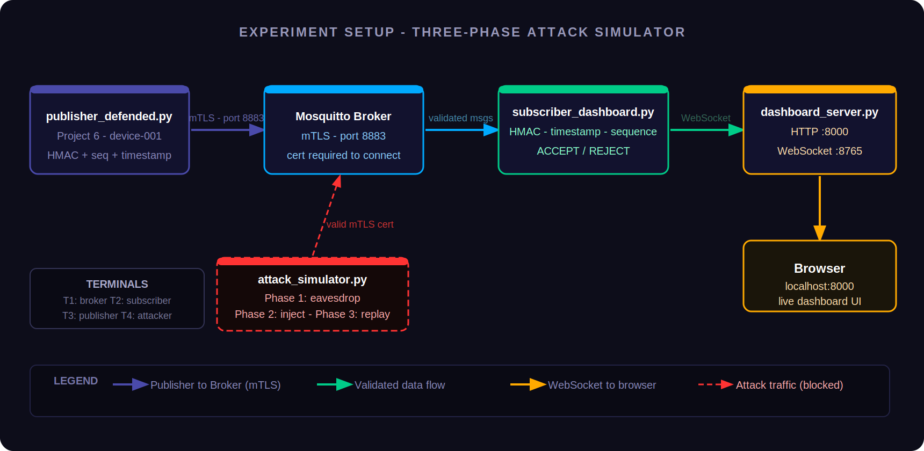
03
Experiment Setup: Three-Phase Attack Simulator
A controlled test against the live pipeline to verify every defense works.
publisher_defended.py → Mosquitto Broker (mTLS, port 8883) → subscriber_dashboard.py → Browser (localhost:8000) + attack_simulator.py
Your Setup Process
1. Started Mosquitto broker with mTLS config on port 8883 (Terminal 1). 2. Launched subscriber_dashboard.py (Terminal 2) — browser opened to localhost:8000. 3. Launched publisher_defended.py (Terminal 3) — device-001 publishing signed readings every 5 seconds. 4. Ran attack_simulator.py (Terminal 4) — three-phase attack sequence against the live pipeline. 5. Monitored the live dashboard in browser and subscriber terminal for accept/reject events in real time.

Slide 5
04
Attack Results: Every Attack Blocked
Which defense caught each attack phase — and why it works.
Attack Phase | What the Attacker Tried | Defense That Caught It | Why It Works
Phase 1: Eavesdrop | Subscribed to all MQTT topics with a valid mTLS cert and read all sensor messages. | None (passive listening) | Eavesdropping cannot be blocked at the protocol level. In production, broker ACLs would restrict topic subscriptions.
Phase 2: Inject | Published a message with fake device ID, 250 PSI pressure reading, and a forged HMAC signature. | HMAC-SHA256 Verification | The subscriber recomputed the HMAC using the shared secret. The forged signature did not match. Message rejected immediately.
Phase 3: Replay | Re-sent a previously captured legitimate message with a valid HMAC signature. | Sequence Counter | The subscriber had already recorded that sequence number from the original message. Duplicate detected and rejected.
✅ Result: 0 attacks succeeded | 100% blocked

Slide 6
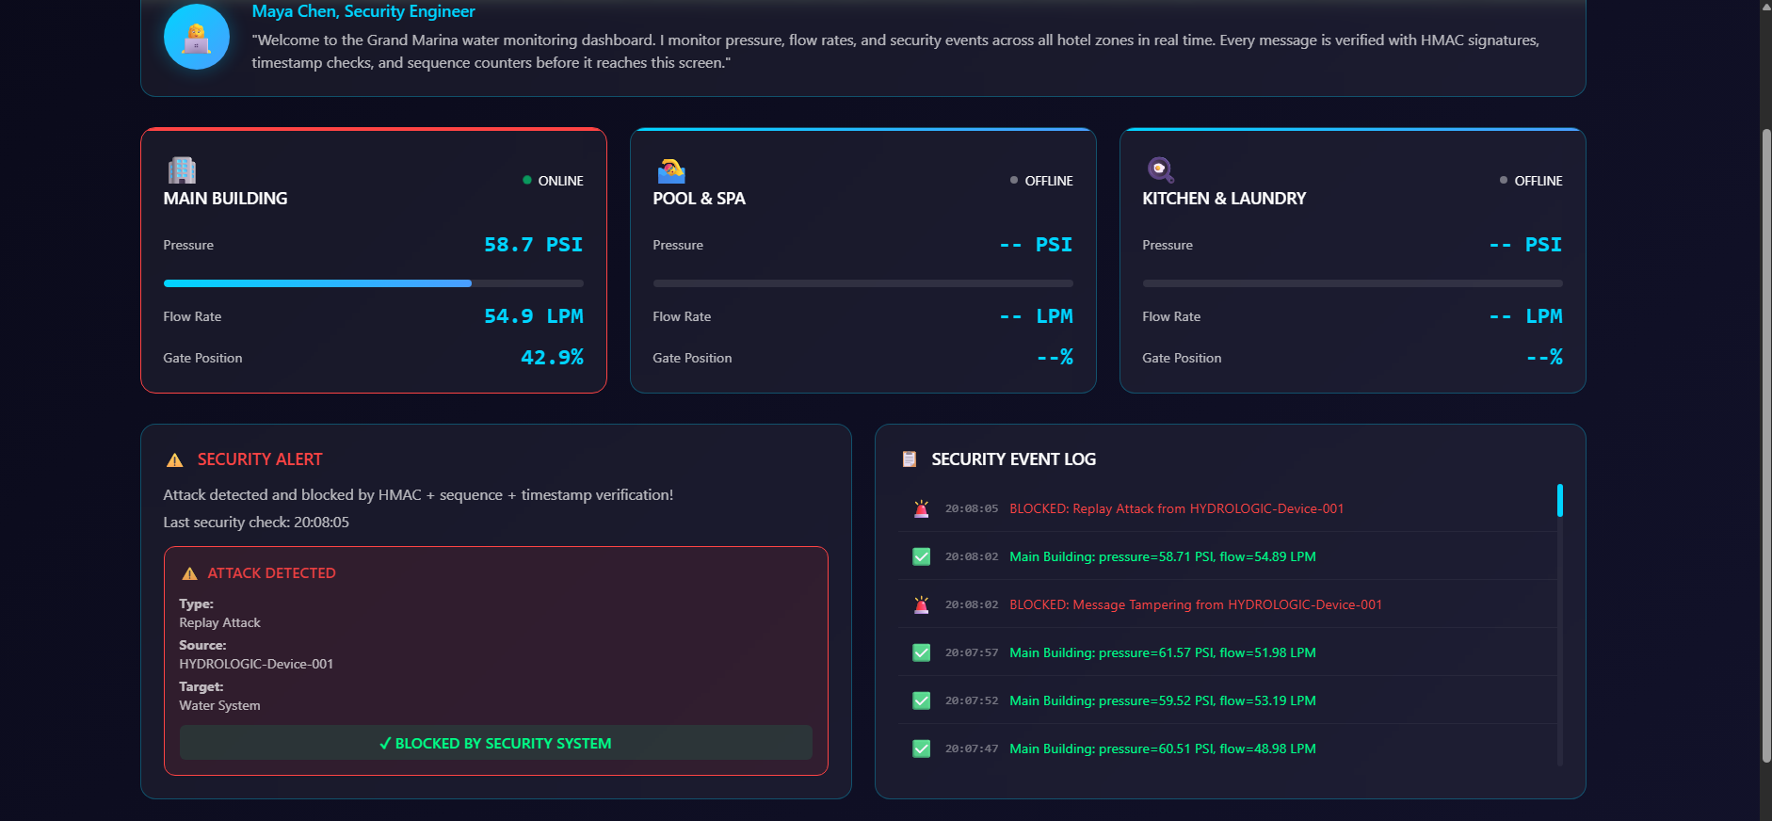
05
Dashboard: Attack Detected
Red alerts, shaking zone cards — every attack caught in real time.
[Insert image or video: Dashboard during active attack Showing red alert banner, shaking zone cards, attack type labels, real-time rejection logs]

Slide 7
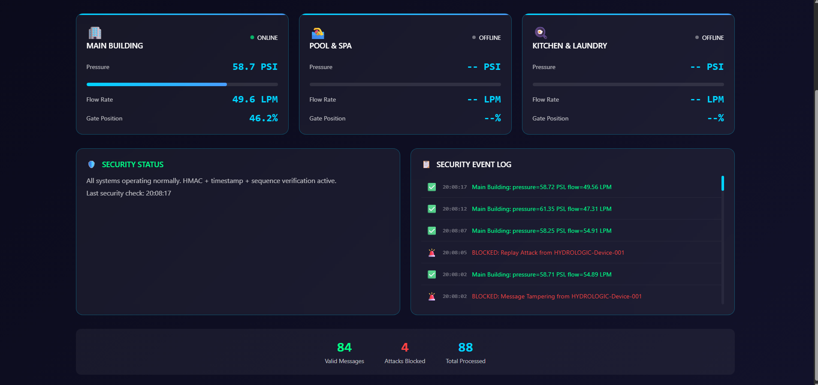
06
Stats: Attacks Blocked
The numbers tell the story — every attack rejected, every valid message accepted.

Slide 8
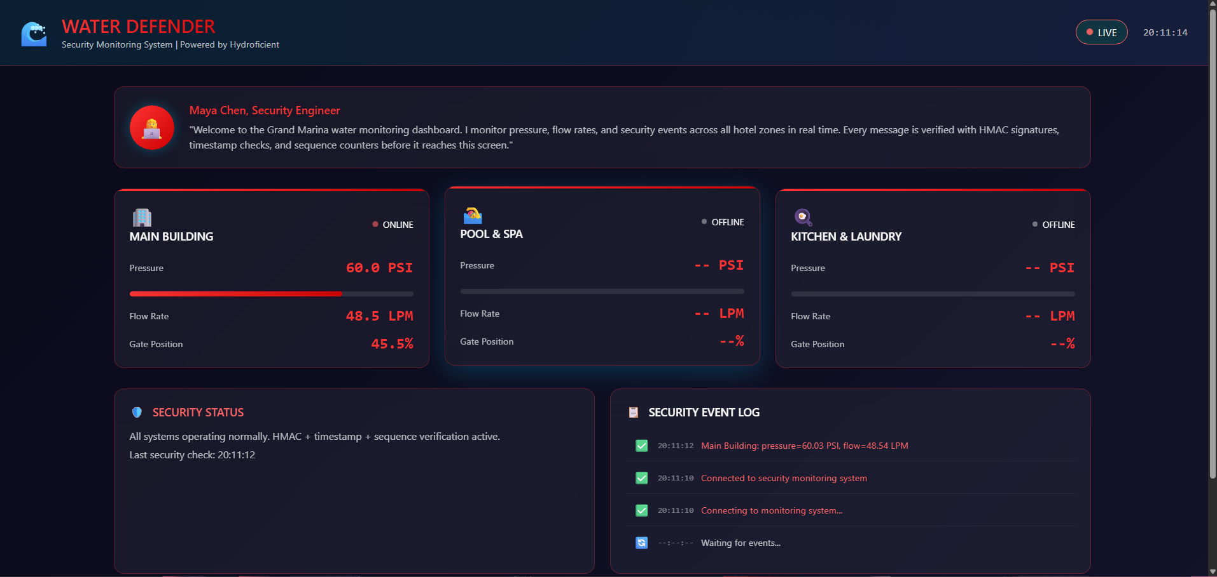
07
Custom Dashboard: Making It Mine
Personalized branding, AI-generated color theme, custom alert rules.

Slide 9
08
Key Insights
What this experiment revealed about IoT security.
1
No single defense is enough
mTLS stops outsiders but not compromised insiders. HMAC stops forgeries but not replays. You need all layers working together.
2
The sequence counter is the most reliable replay defense
Timestamps have a 30-second window that fast replays can still exploit. Sequence counters catch every duplicate with zero tolerance, regardless of timing.
3
Visibility transforms reactive into proactive security
Terminal output told me something happened. The dashboard told me what, when, and which device was targeted in under five seconds. That difference matters at 3 AM.
4
Defense in depth maps directly to real attack patterns
Every defense layer was designed to close a specific gap left by the previous one. Understanding that chain made the entire architecture click into place.

Slide 10
09
Recommendations for Grand Marina
What should happen next to secure the IoT infrastructure at scale.
1
Implement broker ACLs to restrict topic access
Deploy access control lists so each device can only publish or subscribe to its own topic. The current setup allows any authenticated device to read all traffic.
2
Automate certificate rotation before expiry
Device certificates expire. Manual renewal is a single point of failure. Implement automated renewal via a PKI management tool before certificates lapse in production.
3
Deploy the dashboard to a persistent monitoring environment
Running the dashboard locally is sufficient for a demo. Production requires a server-hosted instance with alerting integrations so the operations team is notified automatically.
4
Define an incident response playbook
The dashboard detects attacks in real time but there is no documented procedure for what happens next. A clear escalation path and response protocol should be established before go-live.

Slide 11
Questions?

